Slide 1


Set Theory
LECTURE 1
Adapted from :
https://www.genrica.com/vustuff/MTH202/MTH202_handouts_1_45.pdf

Slide 2
Learning Outcomes
After completing this lecture satisfactorily, a student will:
• Be able to specify and manipulate basic mathematical objects such as sets,
functions, and relations and will also be able to verify simple mathematical
properties that these objects possess.
• Gain experience in using various techniques of mathematical induction (weak,
strong and structural induction) to prove simple mathematical properties of a
variety of discrete structures.

Slide 3
Lecture - 1
Set theory
A well defined collection of {distinct} objects is called a set.
The objects are called the elements or members of the set.
Sets are denoted by capital letters A, B, C …, X, Y, Z.
The elements of a set are represented by lower case letters
a, b, c, … , x, y, z.
If an object x is a member of a set A we write x €A, which reads “x belongs to A” or “x is in A” or “x is an element of A”, otherwise we write x €A, which reads “x does not belong to A” or “x is not in A” or “x is not an element of A”.
TABULAR FORM
Listing all the elements of a set, separated by commas and enclosed within braces or curly brackets{}.
EXAMPLES
In the following examples we write the sets in Tabular Form.
A = {1, 2, 3, 4, 5} is the set of first five Natural Numbers.
B = {2, 4, 6, 8, …, 50} is the set of Even numbers up to 50.
C = {1, 3, 5, 7, 9, …} is the set of positive odd numbers.
NOTE
The symbol “…” is called an ellipsis. It is a short for “and so forth.”

Slide 8
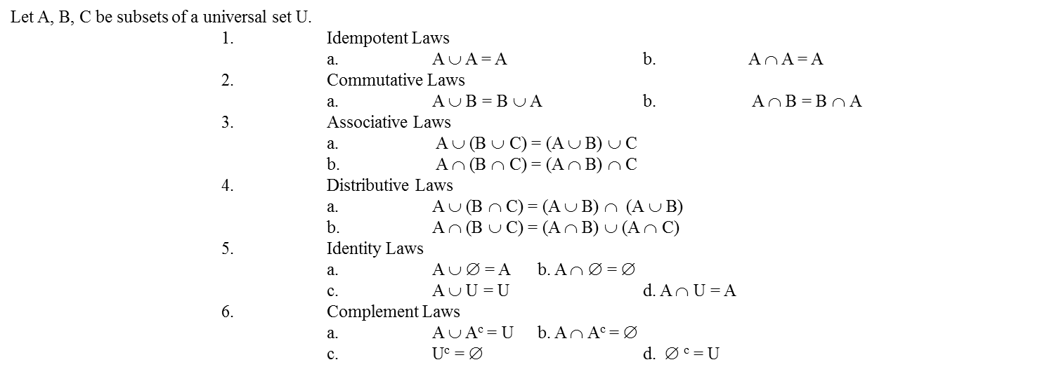
SET IDENTITIES:

Slide 9
7. Double Complement Law
(A^{c}) ^{c} = A
8. DeMorgan’s Laws
a. (A ∪ B)^{c} = A^{c} ∩ B^{c} b. (A ∩ B)^{c} = A^{c} ∪ B^{c}

Slide 10
EXERCISE:
A ⊆ A ∪ B
A – B ⊆ A
If A ⊆ B and B ⊆ C then A ⊆ C
A ⊆ B if, and only if, B^{c} ⊆ A^{c}
Prove that A ⊆ A ∪ B
SOLUTION
Here in order to prove the identity you should remember the definition of Subset of a set. We will take the arbitrary element of a set then show
that, that element is the member of the other then the first set is the subset of the other. So
Let x be an arbitrary element of A, that is x ∈A.
⇒ x ∈A or x ∈B
⇒ x ∈A ∪ B
But x is an arbitrary element of A.
∴ A ⊆ A ∪ B (proved)

Slide 11
2. Prove that A – B ⊆ A
SOLUTION
Let x ∈A – B
⇒ x ∈A and x ∉B (by definition of A – B)
⇒ x ∈A (in particular)
But x is an arbitrary element of A – B
∴ A – B ⊆ A (proved)
3. Prove that A – B ⊆ A
SOLUTION
Let x ∈A – B
⇒ x ∈A and x ∉B (by definition of A – B)
⇒ x ∈A (in particular)
But x is an arbitrary element of A – B
∴A – B ⊆ A (proved)

Slide 12
Prove that if A ⊆ B and B ⊆ C, then A ⊆ C
SOLUTION
Suppose that A ⊆ B and B ⊆ C
Consider x ∈A
⇒ x ∈B (as A ⊆ B)
⇒ x ∈C (as B ⊆ C)
But x is an arbitrary element of A
∴ A ⊆ C (proved

Slide 13
Prove that A ⊆ B iff B^{c} ⊆ A^{c}
SOLUTION:
Suppose A ⊆ B {To prove B^{c} ⊆ A^{c}}
Let x ∈B^{c}
⇒ x ∉B (by definition of B^{c})
⇒ x ∉A
⇒ x ∈A^{c} (by definition of A^{c})
Now we know that implication and its contrapositivity are logically equivalent and the contrapositive statement of if x ∈A then x ∈B is: if x ∉B then x ∉A which is the definition of the A ⊆ B. Thus if we show for any two sets A and B, if x ∉B then x ∉A it means that
A ⊆ B. Hence
But x is an arbitrary element of B^{c}
∴ B^{c} ⊆ A^{c}
Conversely,
Suppose B^{c} ⊆ A^{c} {To prove A ⊆ B}
Let x ∈A
⇒ x ∉ A^{c} (by definition of A^{c})
⇒ x ∉ B^{c} (∴ B^{c} ⊆ A^{c})
⇒ x ∈B (by definition of B^{c})
But x is an arbitrary element of A.
∴ A ⊆ B (proved)

Slide 14
Review Questions
Explain the following:
De’morgan’s Law
Set identities
s

Slide 15
Thank you

